Slide 1
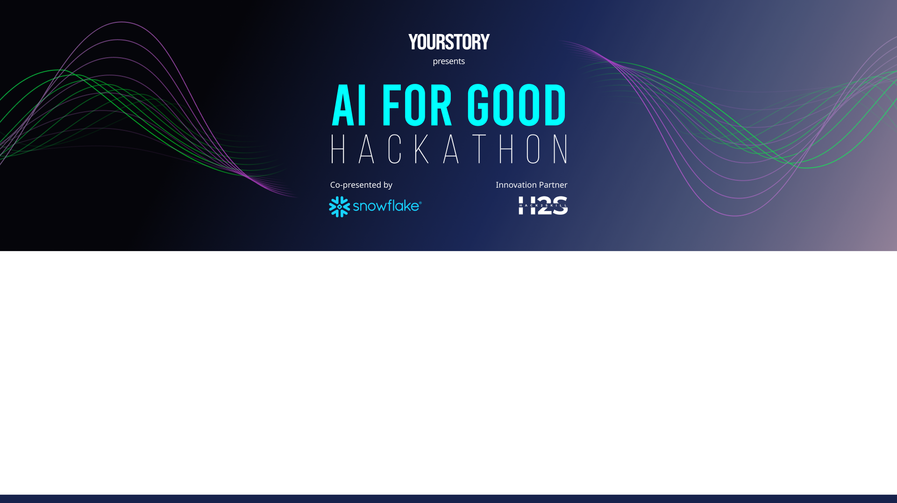
Team Details
Team name: Infinite Recursion
Team leader name: Agniv Dutta
Problem Statement: Hospitals, public distribution systems, and NGOs struggle to maintain optimal stock levels of essential medicines and supplies. Inventory, usage, and procurement data often exist in silos, causing late detection of stock-outs or overstocking, leading to service disruption, wastage, and increased operational costs.

Slide 2
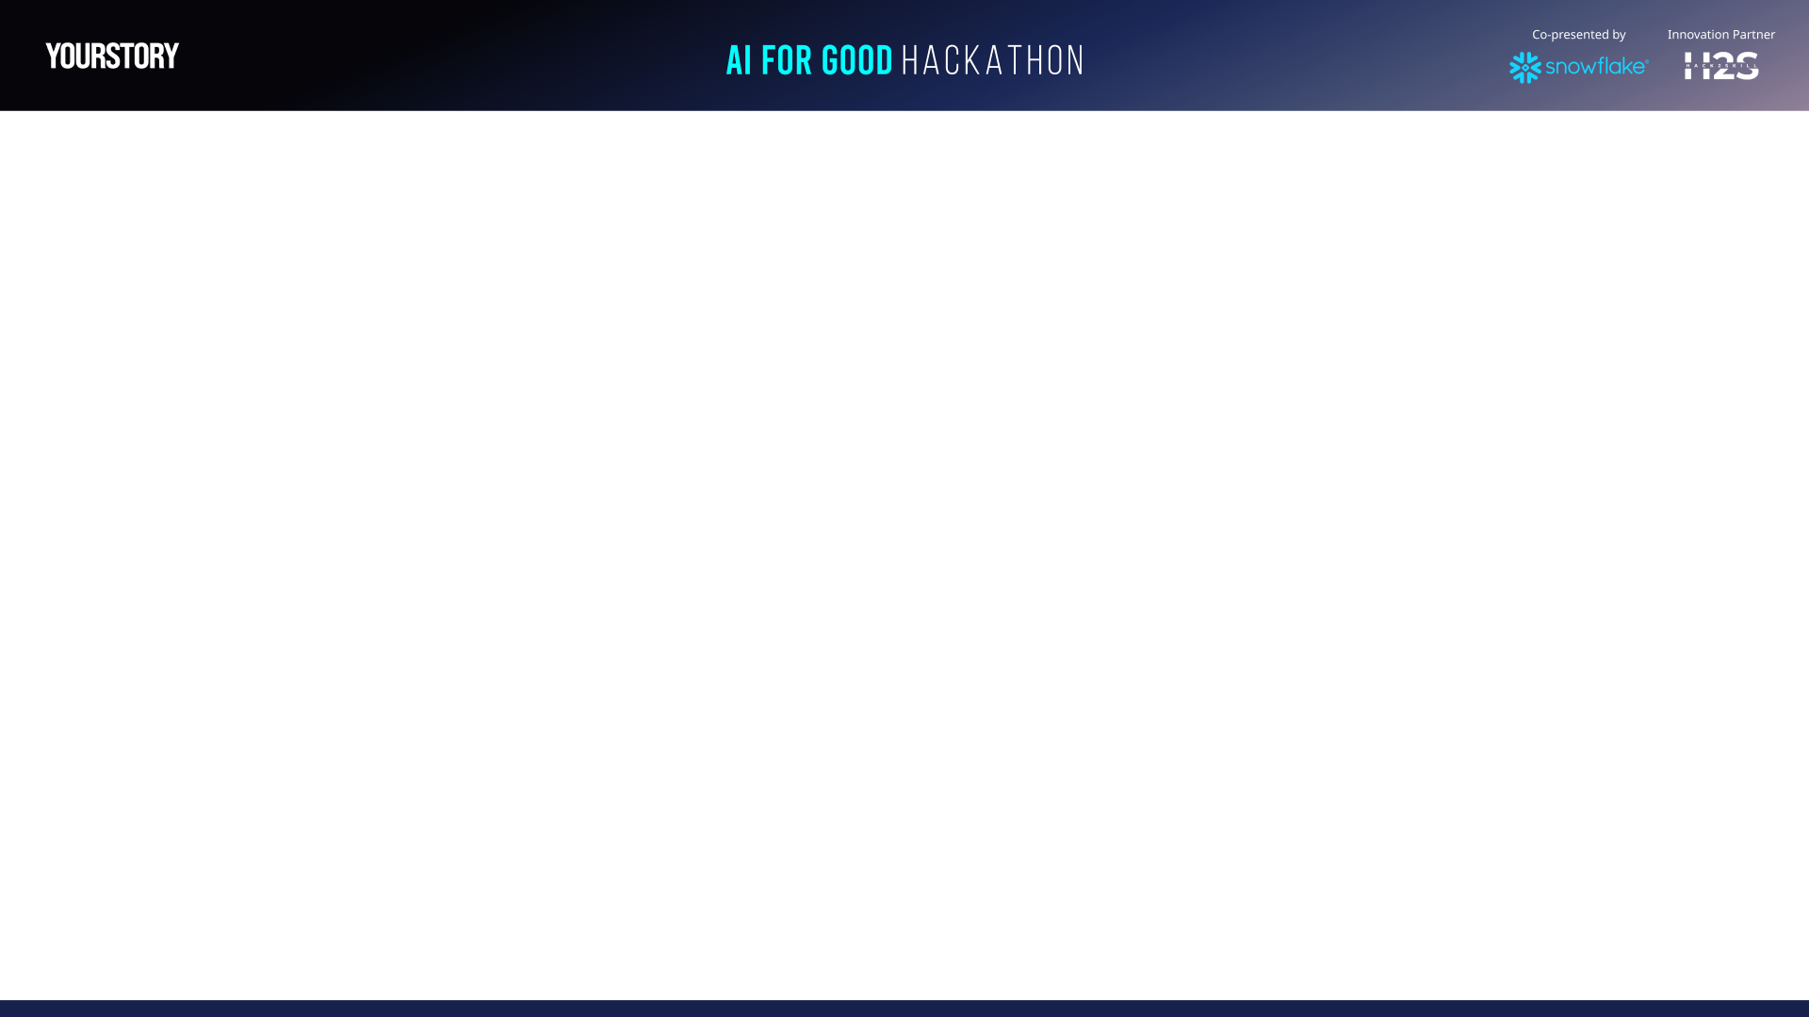
Brief about the idea/protoype
We built an AI-assisted Stock Health & Reorder Intelligence system using Snowflake that unifies daily inventory data across locations and items to:
Monitor stock health in real time
Predict imminent stock-outs
Generate actionable reorder recommendations
Provide plain-language insights for faster decision-making
The solution is implemented as a Snowflake-powered analytics layer with a Streamlit dashboard for visualization and operational use.

Slide 3
Opportunities
How different is it from any of the other existing ideas?
How will it be able to solve the problem?
USP of the proposed solution
Uses Days of Cover instead of static thresholds; Combines consumption trends + lead times; Fully SQL-driven and auto-refreshable using Snowflake
Detects risks before stock runs out; Reduces manual monitoring and spreadsheet dependency; Enables proactive procurement planning
Simple, explainable risk logic; Real-time analytics on SnowflakePlain-language insights for non-technical users
Designed for AI for Good use cases (healthcare, public welfare)

Slide 4
List of features offered by the solution
Unified daily stock ingestion
Automated stock health metrics
Risk classification (Critical / High / Medium / Low)
Reorder quantity recommendations
Heatmap visualization by location & item
Critical stock alerts
Exportable reorder list (CSV)
Plain-language operational insights
Scalable across locations and programs

Slide 5
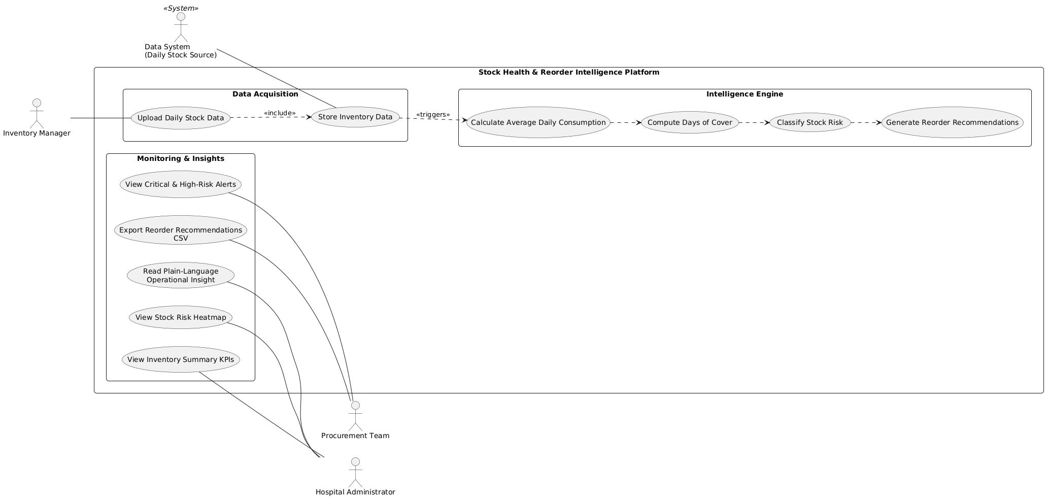
Process flow diagram or Use-case diagram

Slide 6
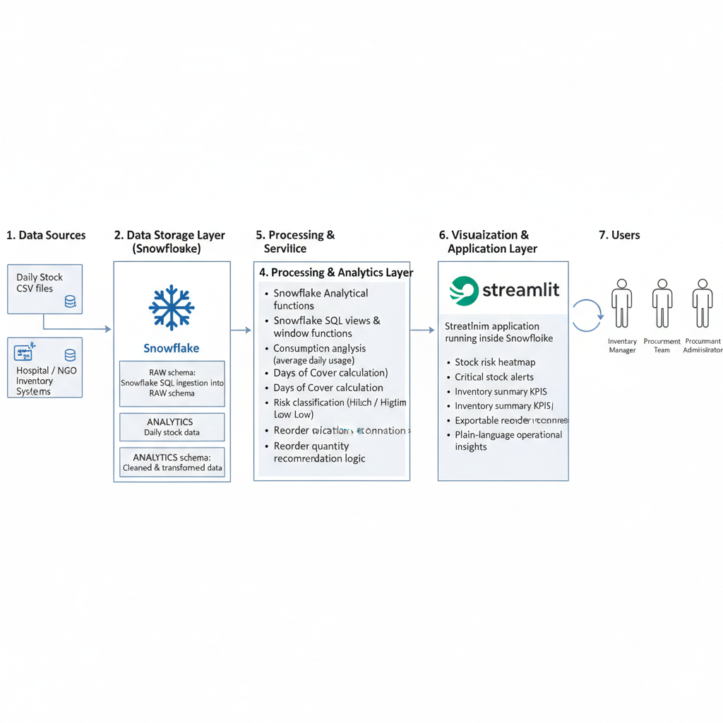
Architecture diagram of the proposed solution

Slide 7
Tech Stack
Data Platform: Snowflake
Query Language: Snowflake SQL
Processing: Window functions, aggregations
Visualization: Streamlit
Programming: Python (Streamlit integration)
Deployment: Snowflake Native environment

Slide 8
Snowflake tools and technology used
Snowflake Worksheets (SQL development)
Snowflake Databases & Schemas
Analytical Views (Gold layer)
Dynamic calculations using SQL
Streamlit in Snowflake
Auto-scaling virtual warehouses
Secure role-based access

Slide 9
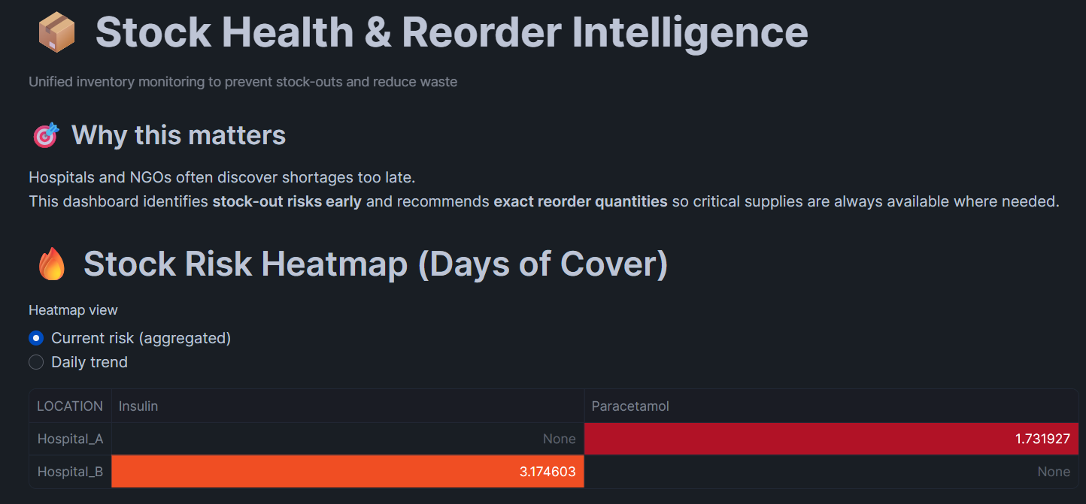
Snapshots of the prototype

Slide 10
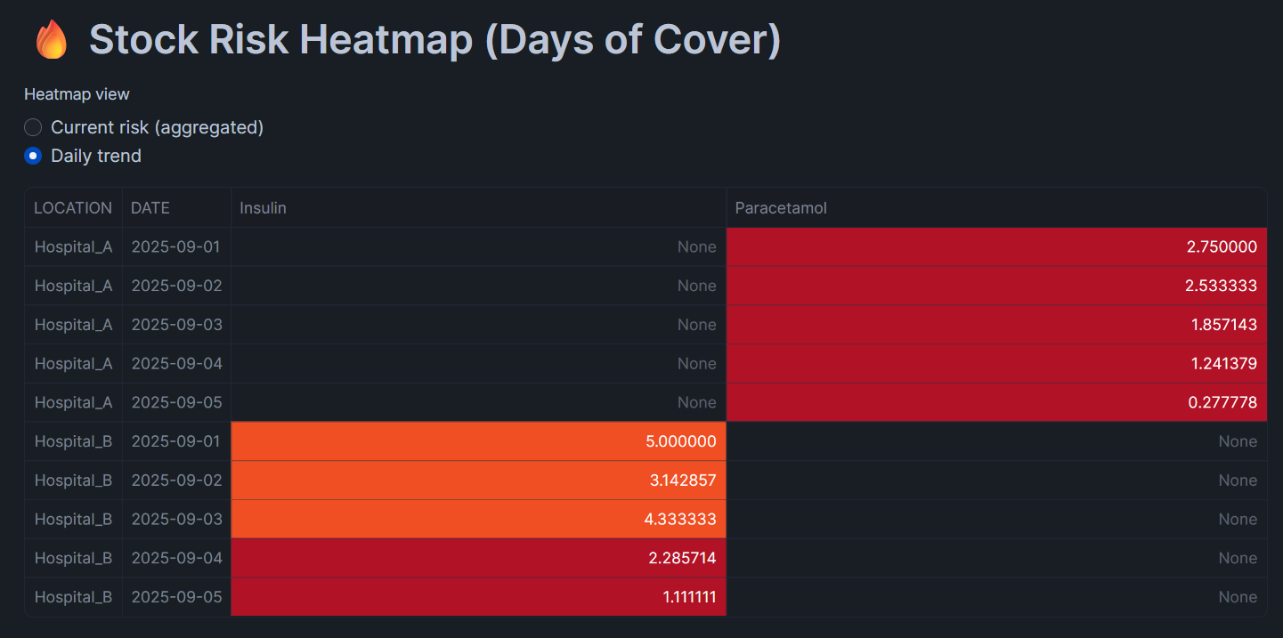

Slide 11
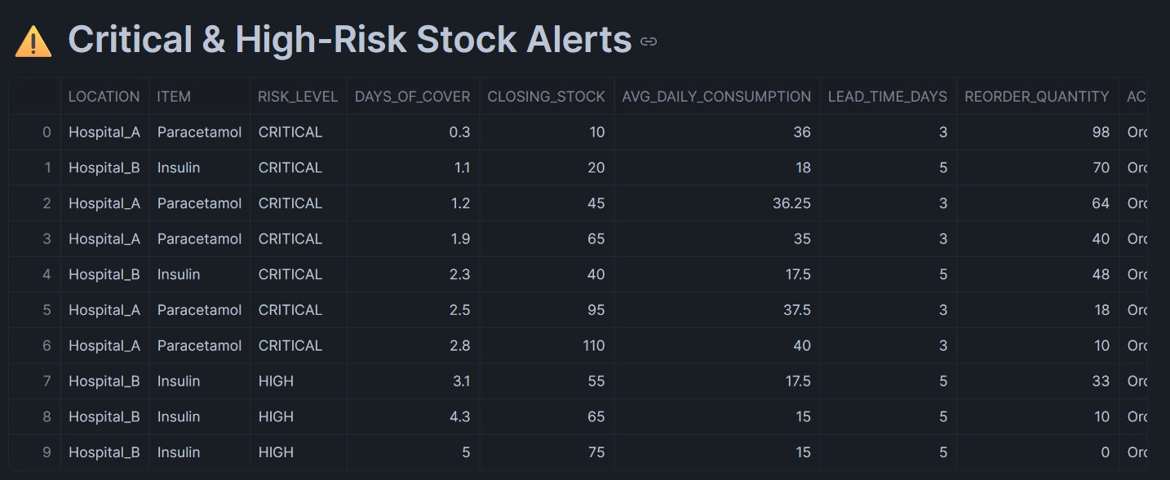

Slide 12
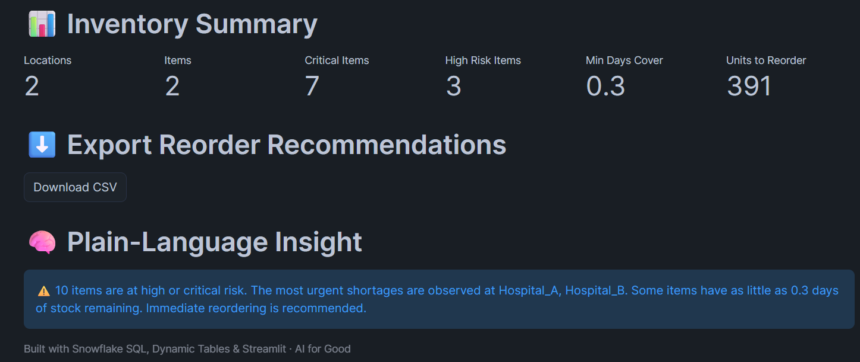

Slide 13
Estimated implementation cost (optional)
Uses Snowflake’s pay-per-use model
Low compute cost due to SQL-based processing
No external ML infrastructure required
Suitable for small NGOs to large public systems

Slide 14
Additional Details/Future Development (if any)
AI-powered demand forecasting
Supplier performance analytics
Mobile-first dashboards
Automated reorder triggers
Integration with ERP / procurement systems
Role-based alerts and notifications

Slide 15
GitHub and Demo video URL
https://github.com/agniv-dutta/stock-health-reorder-intelligence https://youtu.be/B6rFtdEWXEs

Slide 16
